Slide 1
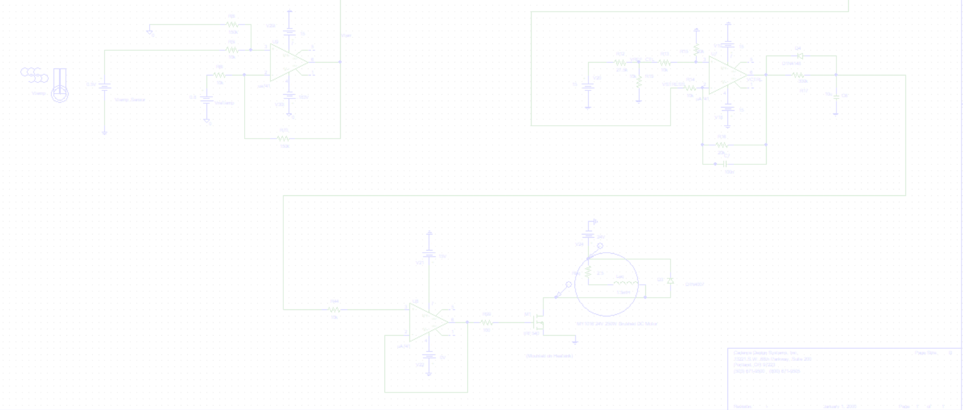

EEE 208 (S) - Electronic Circuits II Laboratory
Jan 2026 Level-2 Term-II Section C
Final Project Demonstration
Design and Implementation of an Intelligent Analog Motor Protection Controller Using
Operational Amplifiers
Submitted by – Group 02
A.H.M Mortuza Alam 2306137 | Faria Tilat Era 2306140 | Mujaddid 2306143 | Miftaha Musarrat 2306144
BANGLADESH UNIVERSITY OF ENGINEERING AND TECHNOLOGY
DEPARTMENT OF ELECTRICAL AND ELECTRONIC ENGINEERING

Slide 2
Outline
Summary
Introduction
Design
Implementation
Analysis and Evaluation
References
EEE 208 (2026) – Final Project Group:- 02 | Intelligent Analog Motor Protection Controller

Slide 3
1. Summary
This project designs an analog protection controller for a 24V DC motor to prevent overheating and insulation breakdown caused by sustained overloads. The system ignores brief startup inrush spikes to avoid unnecessary shutdowns, executes an instant power cutoff during genuine faults, and enforces a 3-second auto-recovery delay before safely reconnecting the motor.
Motor Burnout Prevention
False-Spike Filtering
Dual-Sensor Stress Estimation
Timed Auto-Recovery Delay
EEE 208 (2026) – Final Project Group:- 02 | Intelligent Analog Motor Protection Controller

Slide 4
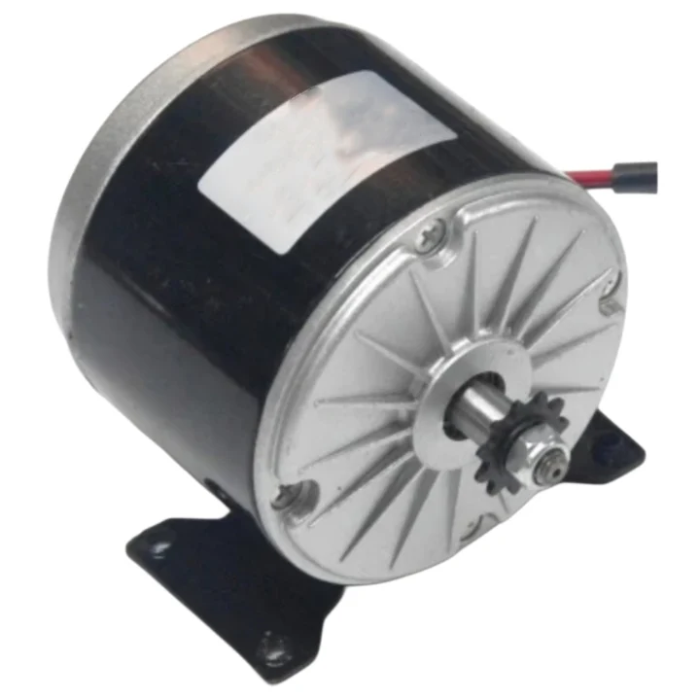
2. Introduction
MY1016 DC Motor Operational Specifications
Basic Ratings
Motor Model: MY1016 Brushed DC Motor
Nominal Supply Voltage: 24 V DC
Rated Power: 250 W
Current Operating Ranges
Normal Operating Range: 0 A – 10 A
Moderate Overload Range: 10 A – 14 A
Critical Fault / Stall Threshold: > 14 A
Thermal Operating Ranges
Nominal Thermal Zone: 0°C – 80°C
Thermal Warning Zone: 80°C – 100°C
Critical Overheat Limit: ≥ 100°C
Target Motor:
Figure: MY1016 24V 250W DC Motor
EEE 208 (2026) – Final Project Group:- 02 | Intelligent Analog Motor Protection Controller

Slide 5
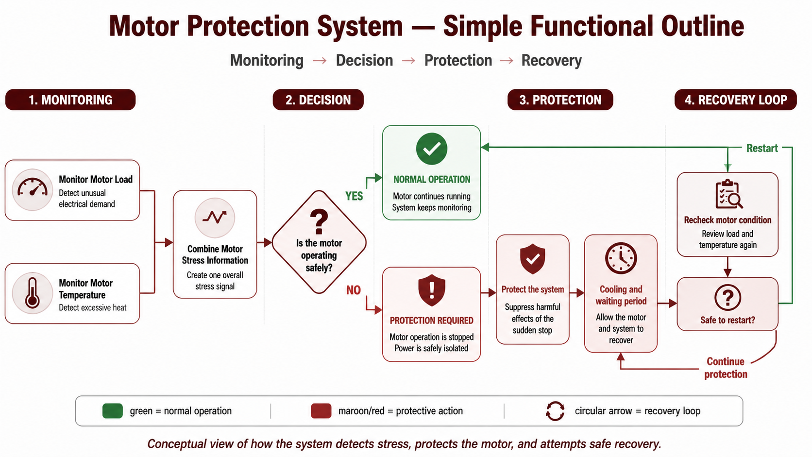
2. Introduction
EEE 208 (2026) – Final Project Group:- 02 | Intelligent Analog Motor Protection Controller

Slide 6
3. Design
3.1 Load Averaging: A current sensor converts the motor load current into a proportional voltage signal, which the op-amp integrator then smooths to match the thermal absorption rate of the motor coils.
3.2 Overload Detection: Differential amplifier subtracts the nominal voltage baseline from real-time load signals.
3.3 Stress Aggregation: Summing amplifier merges electrical overcurrent and thermal sensor signals into a single unified voltage.
3.4 Control & Timing: Decision stage compares total stress against critical thresholds and manages the RC auto-recovery timer.
3.5 Power Isolation: Low-power drive stage controls a power MOSFET to execute clean binary switching and isolate the load.
EEE 208 (2026) – Final Project Group:- 02 | Intelligent Analog Motor Protection Controller

Slide 7
4. Implementation
4.1 Sensor Input & Operational Mapping
Current Sensor Signal (Vin): • Normal (0 A – 10 A): 0.0 V – 1.0 V • Overload (10 A – 14 A): 1.0 V – 1.4 V • Stall / Trip (> 14 A): > 1.4 V | Temperature Sensor Signal (Vtemp): • Normal (0°C – 80°C): 0.0 V – 0.8 V • Warning (80°C – 100°C): 0.8 V – 1.0 V • Shutdown (≥ 100°C): > 1.0 V
EEE 208 (2026) – Final Project Group:- 02 | Intelligent Analog Motor Protection Controller

Slide 8
4. Implementation
Circuit Mathematical Model (Normalized to 3.0V Trip Setpoint)
1. Current Overload Gain (Gain = 7.5):
• Maximum Overload Delta: 14A Trip Limit (1.4V) - 10A Baseline (1.0V) = 0.4V
• Required Gain: 3.0V Trip Threshold / 0.4V Delta = 7.5
• Result: A full 14A current overload alone produces exactly 3.0V (7.5 × 0.4V = 3.0V).
2. Thermal Overload Gain (Gain = 15):
• Maximum Thermal Delta: 100°C Shutdown (1.0V) - 80°C Baseline (0.8V) = 0.2V
• Required Gain: 3.0V Trip Threshold / 0.2V Delta = 15
• Result: A full 100°C thermal overload alone produces exactly 3.0V (15 × 0.2V = 3.0V).
3. Combined Stress Scaling (Vstress ≥ 3.0V):
• Normalizes both pathways so that 100% current overload OR 100% thermal fault independently triggers the 3.0V trip threshold.
• Allows proportional fault aggregation: Partial heat buildup reduces the current threshold required to trip, protecting hot motor windings sooner.
EEE 208 (2026) – Final Project Group:- 02 | Intelligent Analog Motor Protection Controller

Slide 9
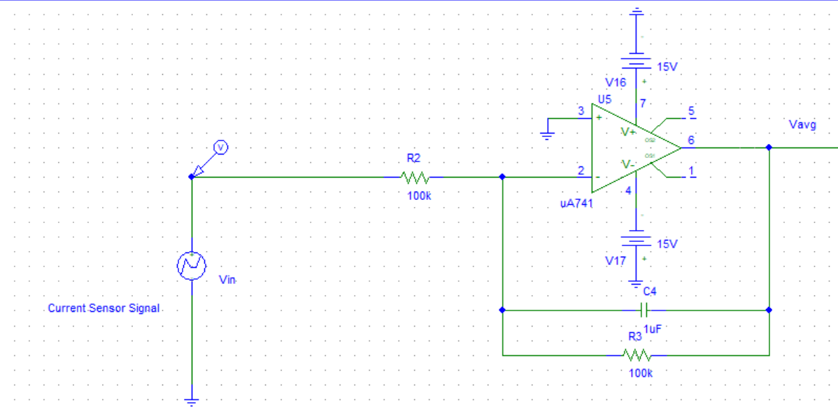
4. Implementation
4.2 Circuit Mathematical Equations & Op-Amp Modules
• Supply Rails: Dual ±15V DC for µA741 op-amps; 24V DC for motor load
• Integrator : Vavg(t) = -(1 / RC) * ∫ Vin(τ) dτ (Filters transient inrush spikes)
Capacitor Selection (C4 = 1 µF): Establishes a 100 ms integration time constant (τ = R3 × C4) to filter short startup inrush spikes (< 100 ms) while passing sustained overload faults to the decision stage.
EEE 208 (2026) – Final Project Group:- 02 | Intelligent Analog Motor Protection Controller

Slide 10
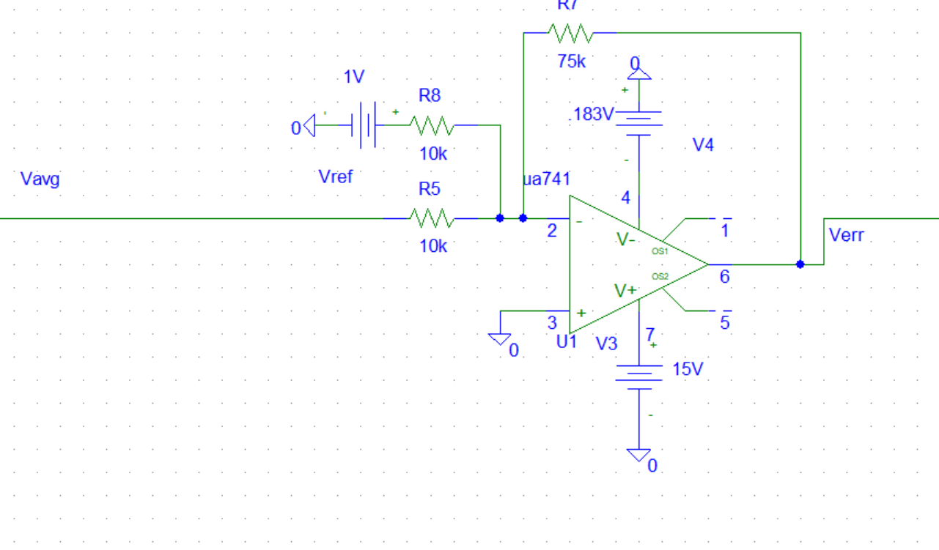
4. Implementation
4.2 Circuit Mathematical Equations & Op-Amp Modules
• Inverting Summer as Differential Error Extractor: (Extracts net current overload above baseline)
The 1.0V reference corresponds to the 10A nominal operating limit, subtracting baseline load so the circuit isolates and amplifies only overcurrent fault signals above 10A.
Verr_current = 7.5 * (Vavg - 1.0V)
EEE 208 (2026) – Final Project Group:- 02 | Intelligent Analog Motor Protection Controller

Slide 11
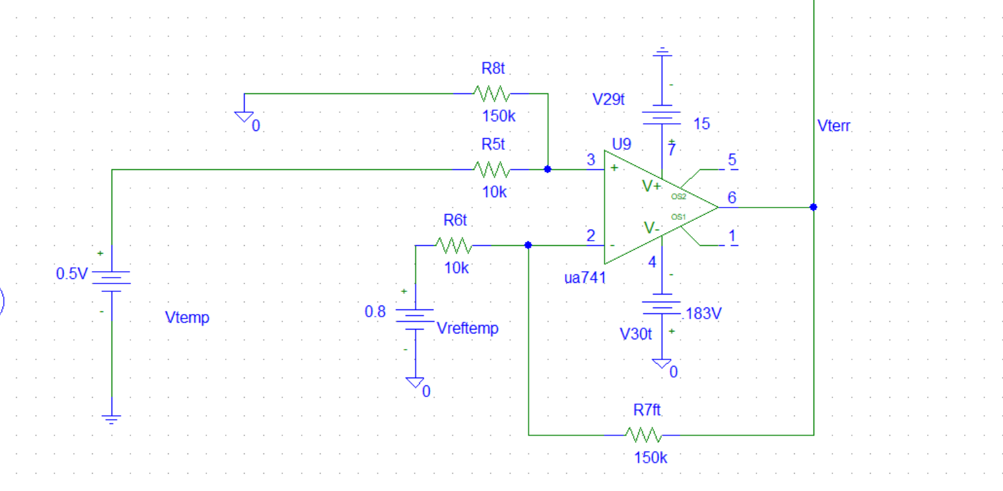
4. Implementation
4.2 Circuit Mathematical Equations & Op-Amp Modules
• Thermal Overload Differential
Amplifier
Core Function: Subtracts the 0.8V reference baseline from Vtemp and amplifies the difference by a gain of 15 (150kΩ / 10kΩ).
0.8V Reference Purpose: Represents the 80°C upper nominal limit, ensuring the circuit isolates and amplifies only the excess heat generated in the warning zone (80°C – 100°C).
Verr_temp = 15 * (Vtemp - 0.8V)
EEE 208 (2026) – Final Project Group:- 02 | Intelligent Analog Motor Protection Controller

Slide 12
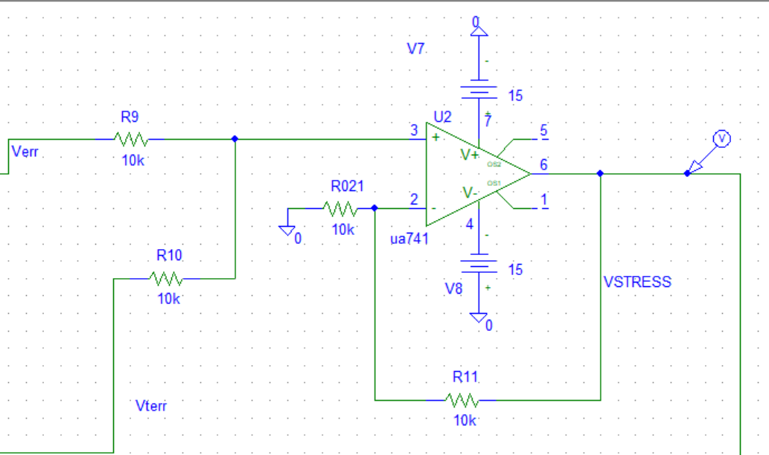
4. Implementation
4.2 Circuit Mathematical Equations & Op-Amp Modules
• Summing Amplifier : (Aggregates load and heat stress)
Vstress = Verr_current + Verr_temp
Vstress = [7.5 * (Vavg - 1.0V)] + [15 * (Vtemp - 0.8V)]
EEE 208 (2026) – Final Project Group:- 02 | Intelligent Analog Motor Protection Controller

Slide 13
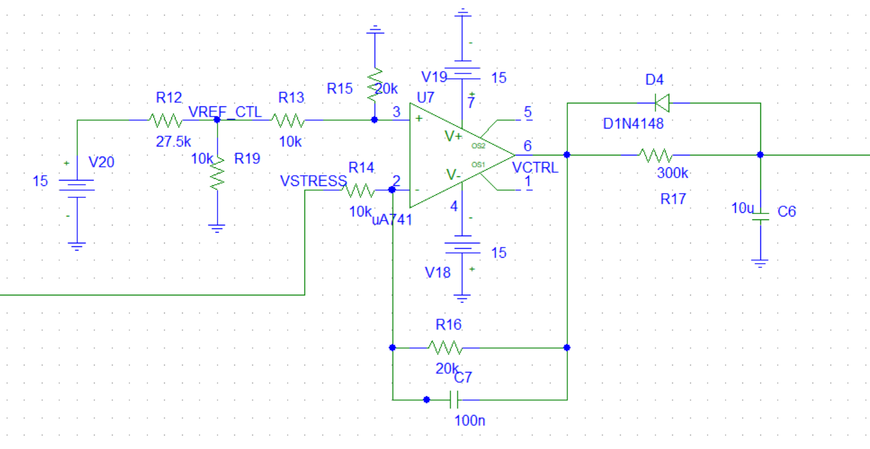
4. Implementation
System Trip Setpoint: Power cutoff triggers when (Verr + Vtemp) ≥ 3.0V
1. Normal Operation (VSTRESS < 3.0V): • Output stays HIGH (15V). • Motor runs normally (MOSFET is ON). 2. Instant Fault Trip (VSTRESS ≥ 3.0V): • Output drops to LOW (0V). • Diode D4 rapidly dumps capacitor C6 charge. • Motor shuts OFF immediately (MOSFET turns OFF). 3. Fault Clears (VSTRESS drops below 3.0V): • Output switches back to HIGH (6V). • Diode D4 blocks reverse current, forcing C6 to charge slowly through R17. 4. Auto-Restart (3.0-Second Delay): • After ~3 seconds (τ = 300kΩ × 10µF), C6 recharges. • Motor automatically turns back ON safely.
EEE 208 (2026) – Final Project Group:- 02 | Intelligent Analog Motor Protection Controller

Slide 14
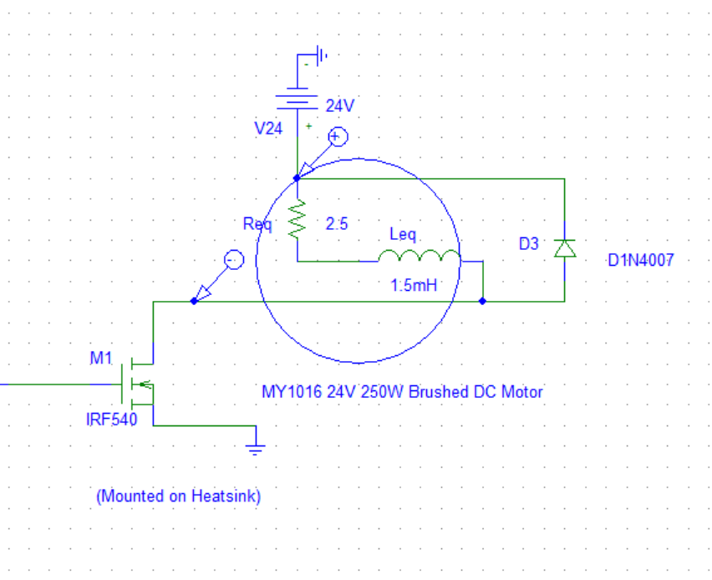
4. Implementation
4.3 Output & Timing Hardware
• Power Driver: IRF540 MOSFET operating strictly in saturation (VGS = 6V ON) or cutoff (VGS = 0V OFF)
• Inductive Protection: 1N4007 flyback diode placed in parallel across the MY1016 motor to clamp inductive voltage spikes during cutoff
EEE 208 (2026) – Final Project Group:- 02 | Intelligent Analog Motor Protection Controller

Slide 15
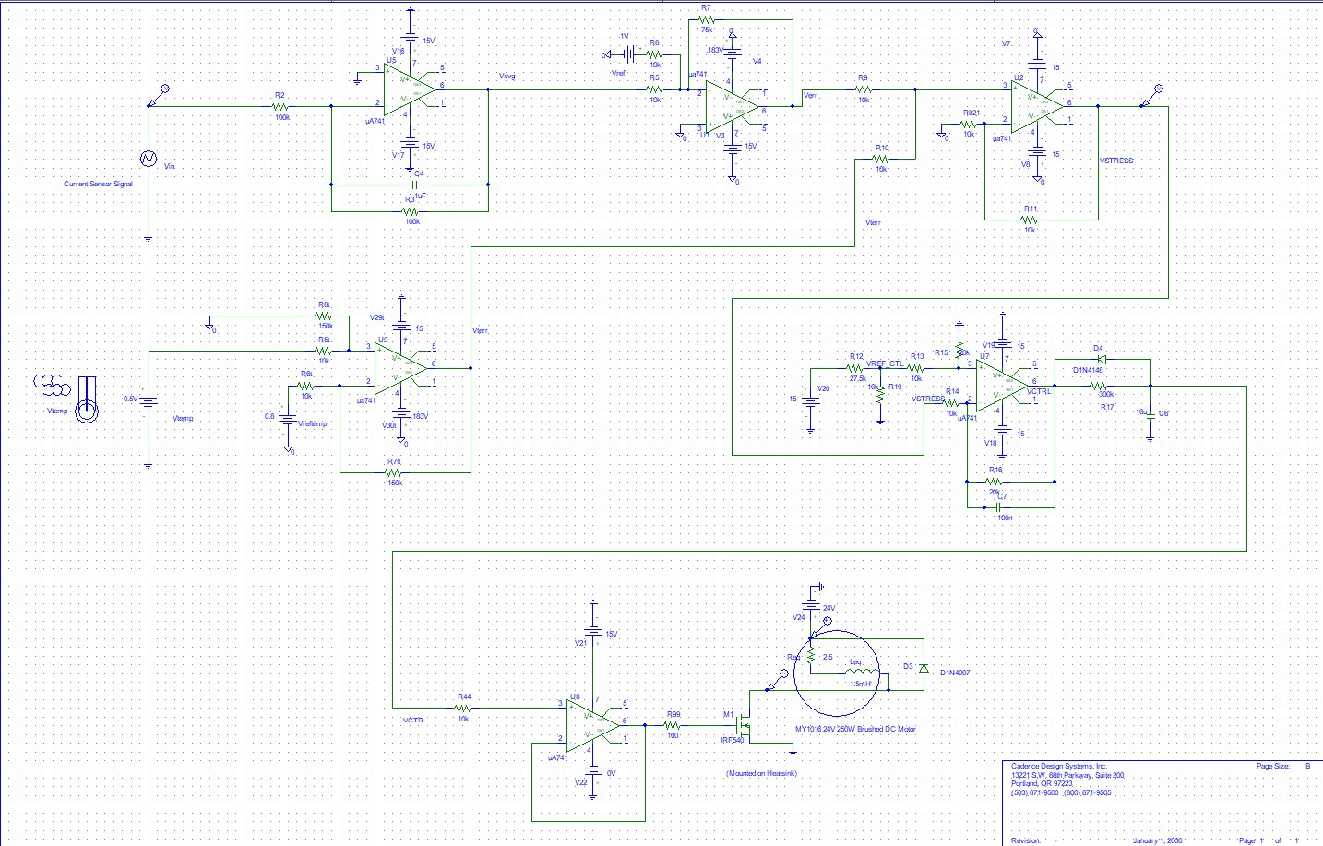
4. Implementation
Complete System Schematic:
EEE 208 (2026) – Final Project Group:- 02 | Intelligent Analog Motor Protection Controller

Slide 16
4. Implementation
Complete System Schematic:
1
3
1. Load Averaging & Overcurrent Signal Conditioning
2. Thermal Fault Signal Processing
3. Stress Aggregation & Fault Decision Logic
4. Gate Drive Buffer & Power Output Interface
2
4
EEE 208 (2026) – Final Project Group:- 02 | Intelligent Analog Motor Protection Controller

Slide 17
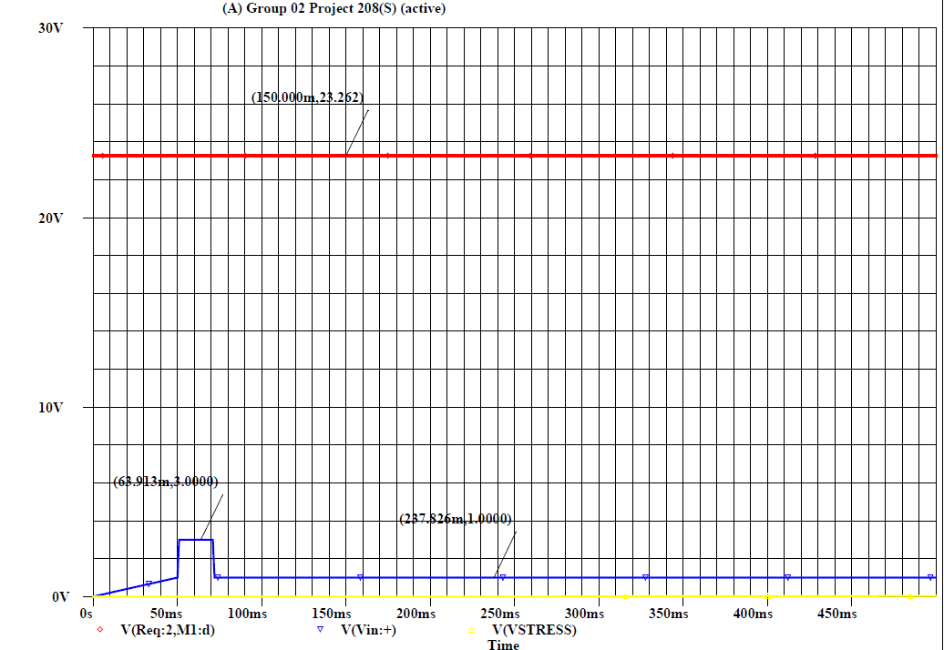
5. Analysis and Evaluation
5.1 Transient Immunity Test (Current Spike)
2 - 3× rated current (~20A–30A) with duration < 100ms.
*Evaluated at Nominal Operating Temperature (T ≤ 80°C | Vtemp ≤ 0.8V)
EEE 208 (2026) – Final Project Group:- 02 | Intelligent Analog Motor Protection Controller

Slide 18
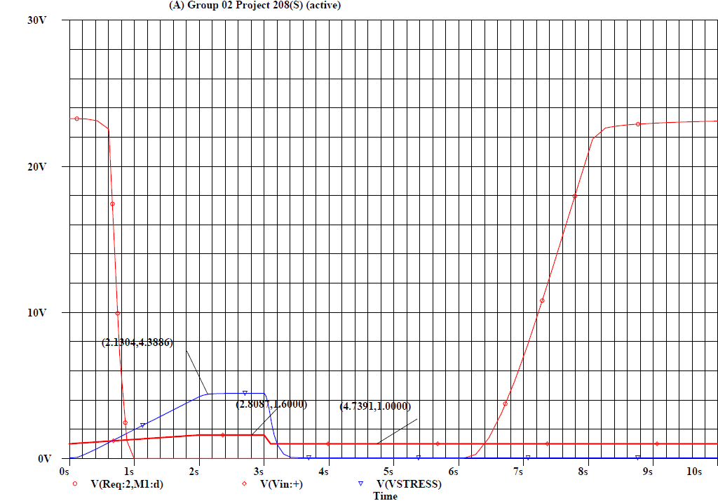
5. Analysis and Evaluation
5.2 Overcurrent Fault & Auto-Recovery
*Evaluated at Nominal Operating Temperature (T ≤ 80°C | Vtemp ≤ 0.8V)
EEE 208 (2026) – Final Project Group:- 02 | Intelligent Analog Motor Protection Controller

Slide 19
5. Analysis and Evaluation
5.2 Overcurrent Fault & Auto-Recovery
Motor OFF (3.0s Auto-Recovery Delay)
*Evaluated at Nominal Operating Temperature (T ≤ 80°C | Vtemp ≤ 0.8V)
EEE 208 (2026) – Final Project Group:- 02 | Intelligent Analog Motor Protection Controller

Slide 20
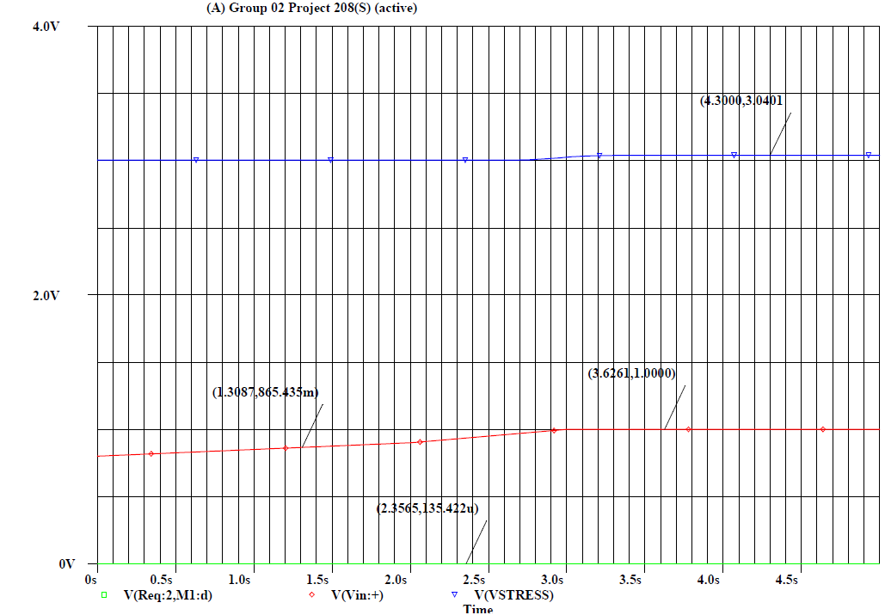
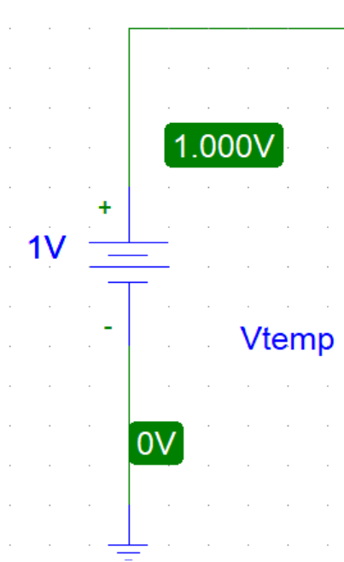
5. Analysis and Evaluation
5.3 Pure Thermal Overload
Evaluated under Pure Thermal Overload (T = 100°C | Vtemp = 1.0V, Continuous Load ≤ 10A)
EEE 208 (2026) – Final Project Group:- 02 | Intelligent Analog Motor Protection Controller

Slide 21
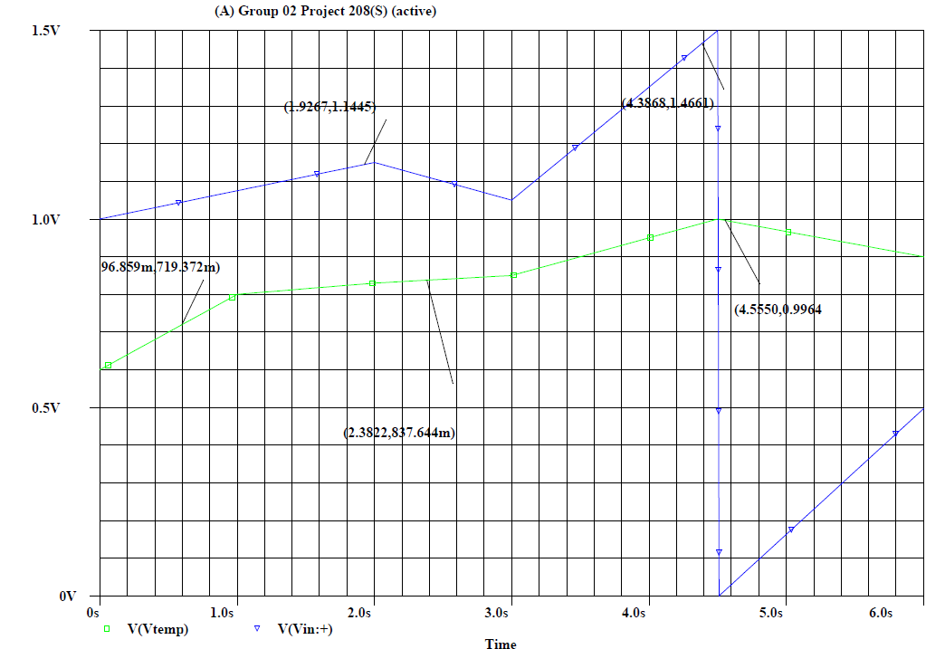
5. Analysis and Evaluation
5.4 Combined Stress Aggregation (Load + Temp)
EEE 208 (2026) – Final Project Group:- 02 | Intelligent Analog Motor Protection Controller

Slide 22
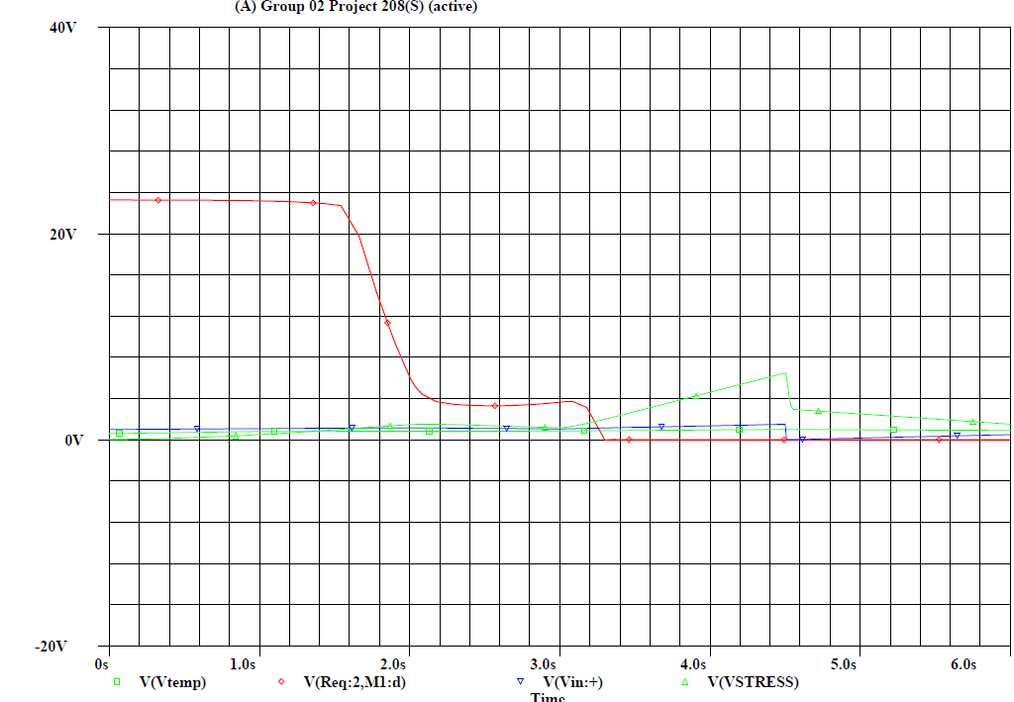
5. Analysis and Evaluation
5.4 Combined Stress Aggregation (Load + Temp)
Continuous temperature rise from t = 2.0s triggers a motor shutdown
EEE 208 (2026) – Final Project Group:- 02 | Intelligent Analog Motor Protection Controller

Slide 23
6. References
[1] R. L. Boylestad and L. Nashelsky, Electronic Devices and Circuit Theory, 11th ed. Upper Saddle River, NJ: Pearson, 2012.
[2] A. S. Sedra and K. C. Smith, Microelectronic Circuits, 7th ed. New York, NY: Oxford University Press, 2015.
EEE 208 (2026) – Final Project Group:- 02 | Intelligent Analog Motor Protection Controller

Slide 24
Thank You!

